Slide 1
ONLINE BANKING MANAGEMENT

Slide 2
INTRODUCTION
The Online Banking Application is a Browser based Application to keep track of Account details, Fund Transfer, Transaction details and other events.
It is an online responsive website, which is easily available to customers on laptops, desktops, mobile phones and tablets. Using this system people can apply to open new bank account, FD and request banking services like transfer funds, check balance, and ATM pin change
The technologies used are React, JavaScript, Spring Boot REST API with MVC and MySQL.

Slide 3
FEATURES
REGISTER & LOGIN
OPEN NEW FD
Registration for new customer to use online banking system. Existing customer can login
Customers can create a new Fixed Deposit
CHECK BALANCE
FUND TRANSFER
Customers can check their balance and their previous transactions.
Customers can transfer funds to other customers
CHANGE PIN
EVENTS
Existing customers can change their ATM Pin details.
Customers and Users can check upcoming events and register for it.

Slide 4
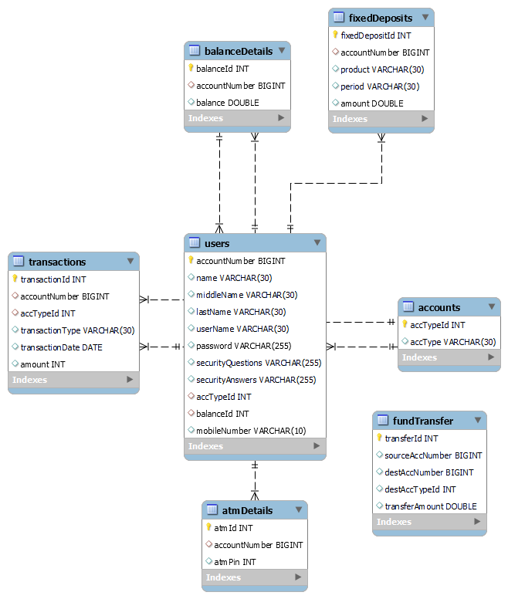
SCHEMA

Slide 5
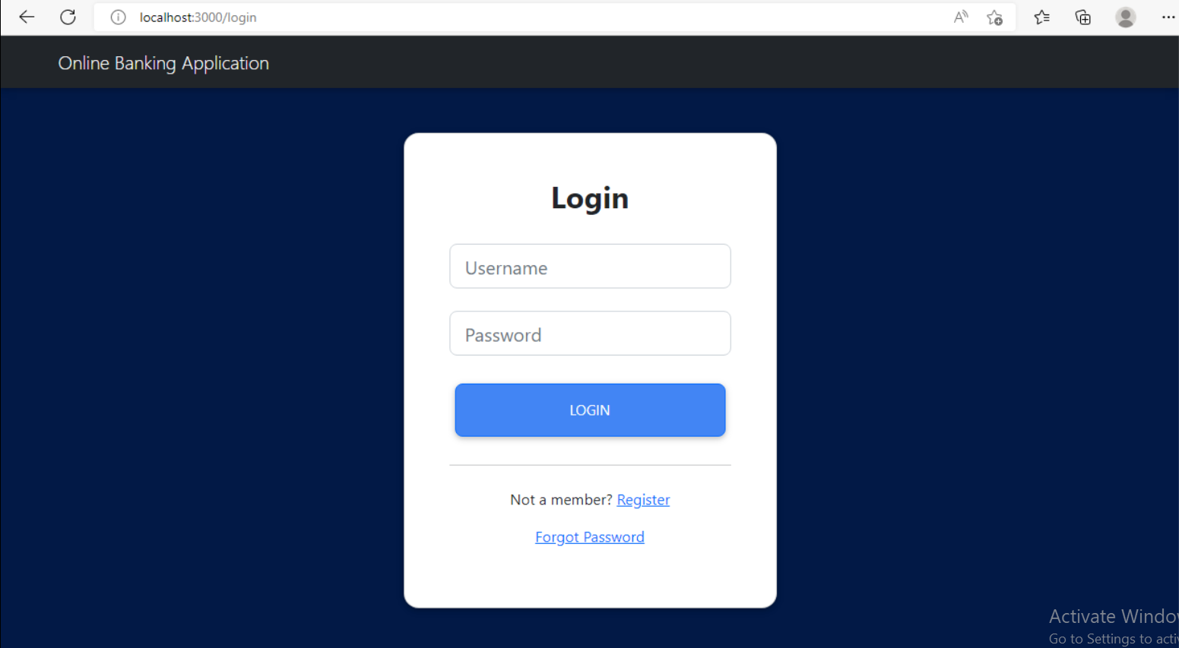
LOGIN

Slide 6
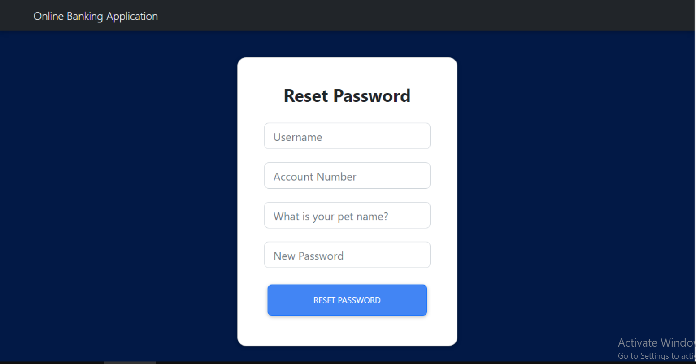
RESET PASSWORD

Slide 7
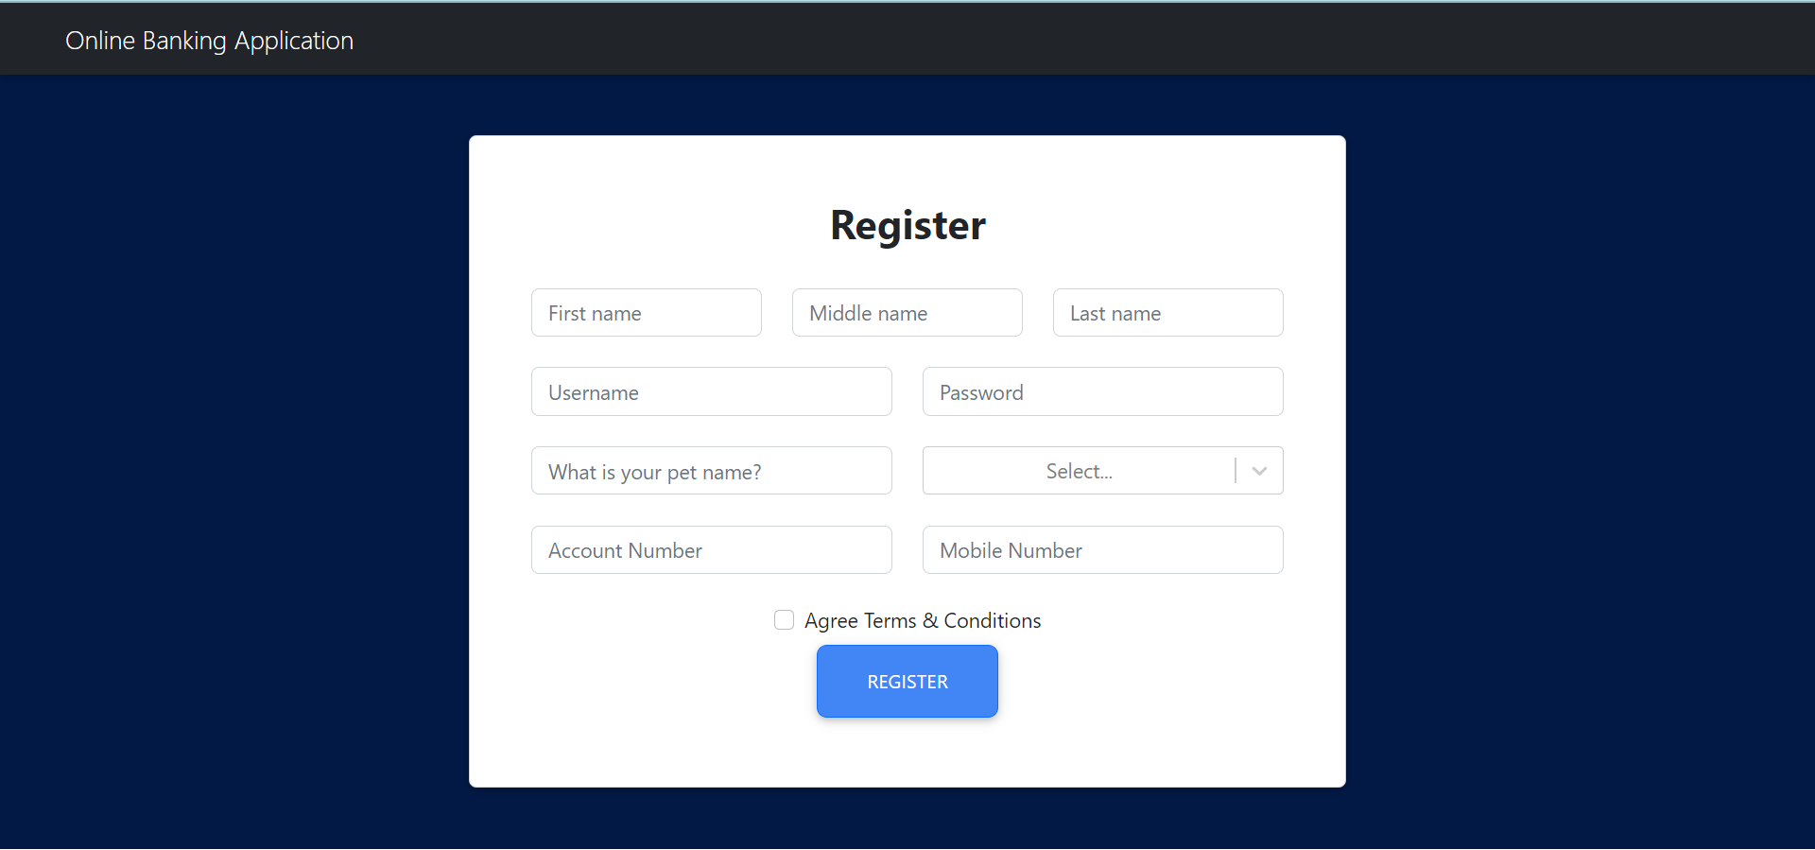
REGISTER

Slide 8
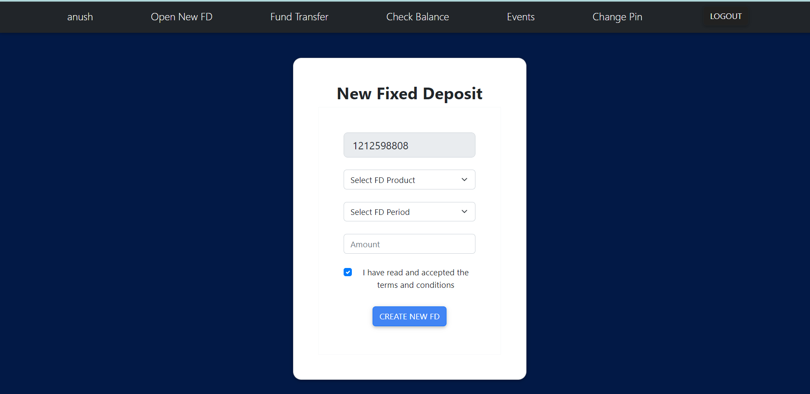
OPEN NEW FD

Slide 9
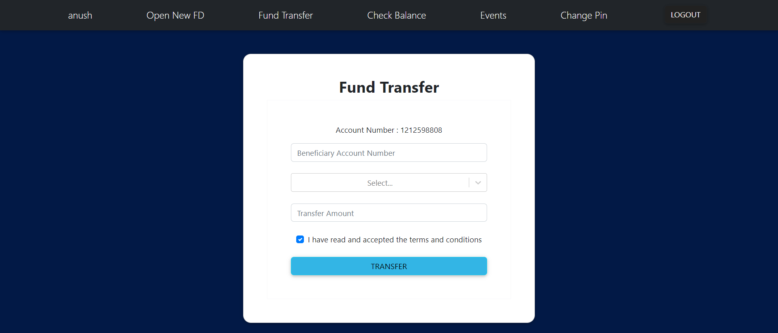
FUND TRANSFER

Slide 10
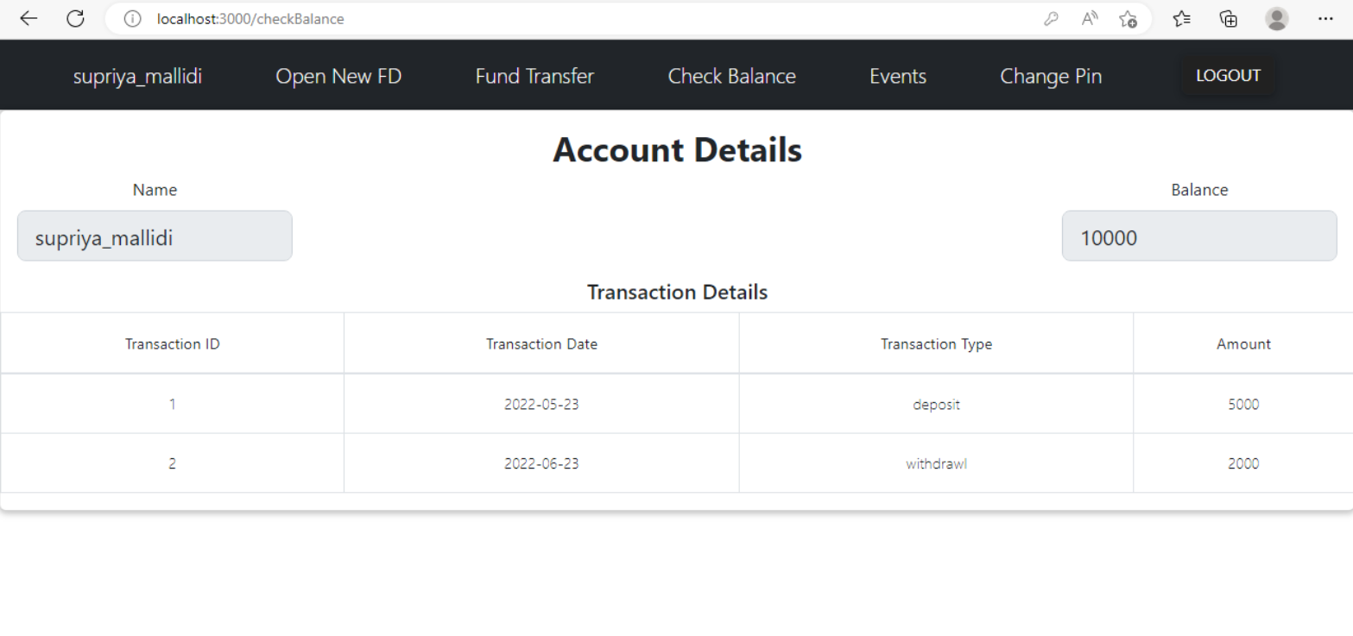
CHECK BALANCE

Slide 11
THANKS

